Slide 1



ReactJS Lesson

Slide 2

What is ReactJS?
React or React.js is a free and open-source front-end JavaScript library for building user interfaces based on components.
It is maintain by Meta and community of individual developers
React can be used to develop single-page web application

Slide 3
Prerequisite
Javascript Fundamentals (Object, Array, Classes, Arrow functions, Array Foreach, filter, maps, API, destructuring, promise, async/await, module)
Html
Css

Slide 4
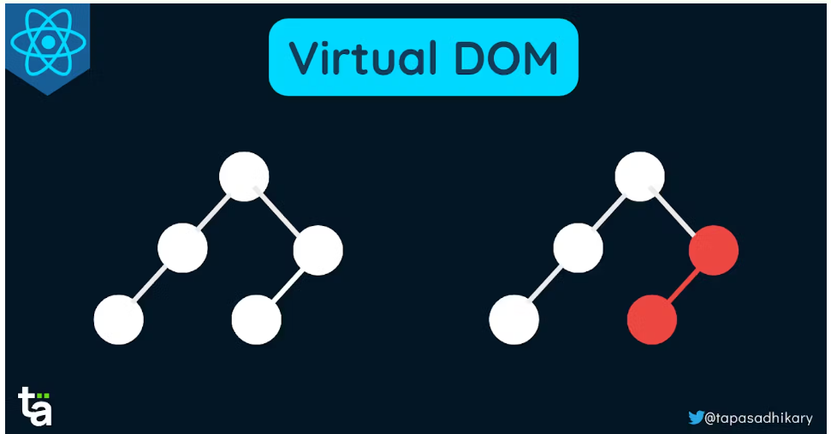
React Virtual DOM
is an in-memory representation of the real DOM elements generated by React components before any changes are made to the page

Slide 5
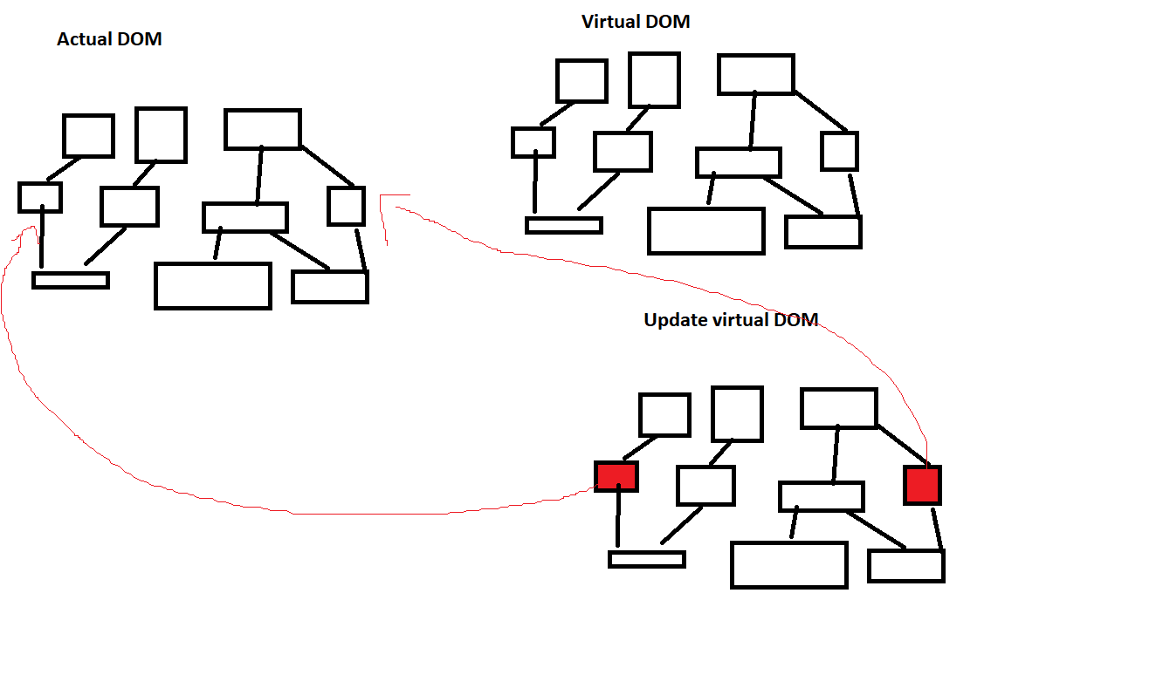
Virtual DOM

Slide 6
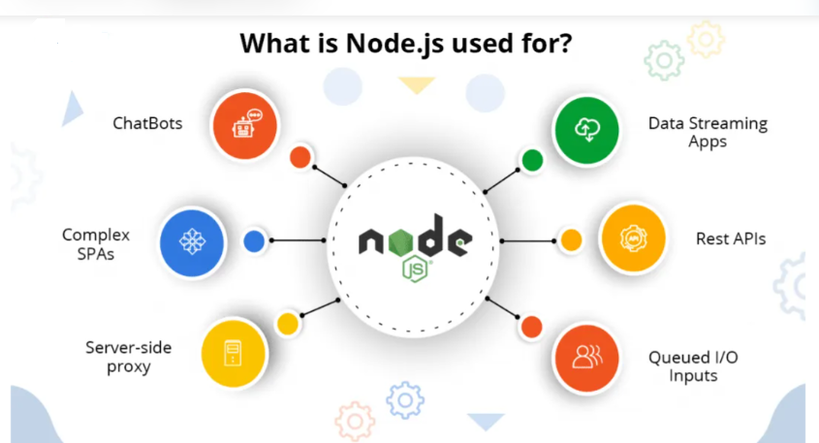
Node.js
Is an open-source and cross-platform JavaScript runtime environment.
It is a Javascript engine that makes possible for Javascript to run in stand alone machine, not only in browser.
Because of Node.js is frameworks like react, angular was created.
Get it in this link https://nodejs.org/

Slide 7
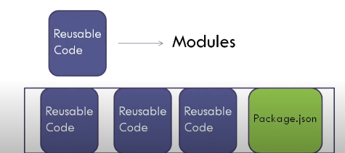
NPM
Package manager for Javascript
A way to share you code with other developers

Slide 8
NPM Commands
npm help
npm install –h
npm install
npm uninstall
npm update
npm list
npm install <packagename> -g
npm uninstall <packagename> -g
npm list –g
npm prune

Slide 9
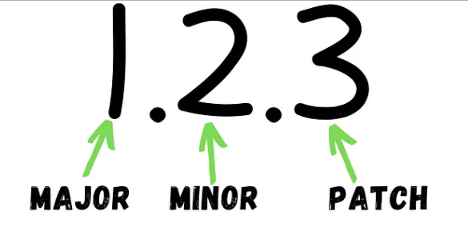
NPM Semantic Versioning

Slide 10
Setup using npx
npx create-react-app

Slide 11
Vite
Is one of the most popular react build tool in the market.
npm create vite@latest <project name>

Slide 12
Cleaning up projects
Remove index.css

